Slide 1
University of Bolton School of Art and Creative Technologies MSc Data Analytics and Technologies Master’s Thesis Viva
Student Name: Dare Akindiya
Student Number: 2123296
Empirical Evaluation of Predicting Carbon Emissions in Europe: A Comparative Analysis and Evaluation
Academic Supervisor: Dr Pradeep Hewage
Date : 9th May 2023

Slide 2

01
PROBLEM STATEMENT
Predicting future carbon emissions is a complex task that requires a comprehensive understanding of the factors influencing emissions. Not using accurate and reliable prediction models will limit policymakers' ability to make informed decisions and implement effective strategies for reducing carbon emissions. Therefore, there is a need to develop and evaluate models that can accurately predict carbon emissions in Europe based on available datasets.

Slide 3


02
AIM
To predict five years of carbon emission in Europe using a proposed model. Evaluate the model against baseline machine learning models and cutting-edge deep learning models.

Slide 4

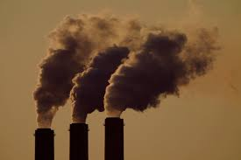
03
OBJECTIVES
RESEARCH QUESTIONS
Can Random Forest (proposed model) be used to predict five years of carbon emission in Europe?
Can the proposed model give better accuracy than the baseline machine learning models?
Can the proposed model be more accurate than cutting-edge deep learning models?
To demonstrate that Random Forest (proposed model) can predict five years of carbon emission in Europe
To evaluate the proposed model with baseline machine learning models
To evaluate the proposed model with cutting-edge deep learning models

Slide 5
04
DATA PRE-PROCESSING
1
FEATURES SELECTION
European countries from the dataset and filter the data to include only 1990 to 2020. Additionally, six columns were dropped to retain only the country name, year, and CO₂ emission columns
TABLE PIVOTING
DATA
PRE-PROESSING
2
The dataset was pivoted to convert the rows into columns and convert the data into a single row list of [1 row by 1488 columns].
SLIDING WINDOW
3
Using a window size of 35 resulted in a transformed dataset with 1454 rows and 35 columns.

Slide 6
05
MODEL DEVELOPMENT
BASELINE MODEL
PROPOSED MODEL
Linear Regression
Decision Tree models
.
Random Forest
1
2
3
4
NORMALISATION
CUTTING EDGE MODEL
A standard scale normalises the processed dataset to avoid one variable being dominant.
LSTM
MLP
NN

Slide 7
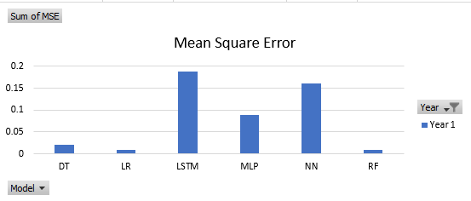
06
Year 1 Result
S/N | Category | Models | Year | Accuracy | MSE
1 | ML Baseline models | LR | Year 1 | 0.98 | 0.01
2 |  | DT | Year 1 | 0.98 | 0.02
3 | Deep Learning models | NN | Year 1 | 0.7877 | 0.1614
4 |  | LSTM | Year 1 | 0.7514 | 0.1889
5 |  | MLP | Year 1 | 0.8825 | 0.0893
6 | Proposed model | RF | Year 1 | 0.99 | 0.01

Slide 8
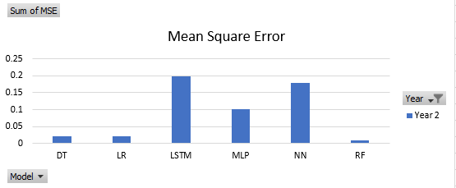
07
Year 2 Result
S/N | Category | Models | Year | Accuracy | MSE
1 | ML Baseline models | LR | Year 2 | 0.97 | 0.02
2 |  | DT | Year 2 | 0.98 | 0.02
3 | Deep Learning models | NN | Year 2 | 0.7718 | 0.1784
4 |  | LSTM | Year 2 | 0.7452 | 0.1992
5 |  | MLP | Year 2 | 0.8707 | 0.1011
6 | Proposed model | RF | Year 2 | 0.99 | 0.01

Slide 9
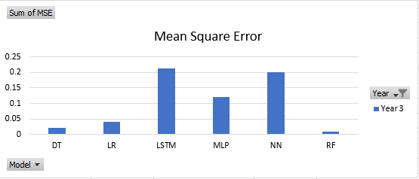
08
Year 3 Result
S/N | Category | Models | Year | Accuracy | MSE
1 | ML Baseline models | LR | Year 3 | 0.95 | 0.04
2 |  | DT | Year 3 | 0.97 | 0.02
3 | Deep Learning models | NN | Year 3 | 0.7511 | 0.2011
4 |  | LSTM | Year 3 | 0.7364 | 0.213
5 |  | MLP | Year 3 | 0.8505 | 0.1208
6 | Proposed model | RF | Year 3 | 0.98 | 0.01

Slide 10
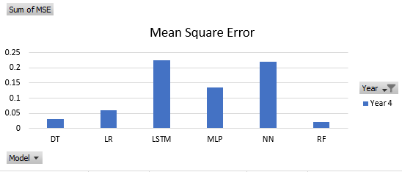
09
Year 4 Result
S/N | Category | Models | Year | Accuracy | MSE
1 | ML Baseline models | LR | Year 4 | 0.93 | 0.06
2 |  | DT | Year 4 | 0.97 | 0.03
3 | Deep Learning models | NN | Year 4 | 0.7338 | 0.2204
4 |  | LSTM | Year 4 | 0.7269 | 0.2261
5 |  | MLP | Year 4 | 0.8358 | 0.1359
6 | Proposed model | RF | Year 4 | 0.98 | 0.02

Slide 11
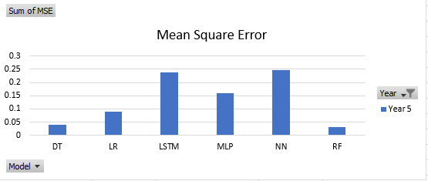
10
Year 5 Result
S/N | Category | Models | Year | Accuracy | MSE
1 | ML Baseline models | LR | Year 5 | 0.90 | 0.09
2 |  | DT | Year 5 | 0.96 | 0.04
3 | Deep Learning models | NN | Year 5 | 0.7093 | 0.2476
4 |  | LSTM | Year 5 | 0.722 | 0.2368
5 |  | MLP | Year 5 | 0.8142 | 0.1582
6 | Proposed model | RF | Year 5 | 0.97 | 0.03

Slide 12
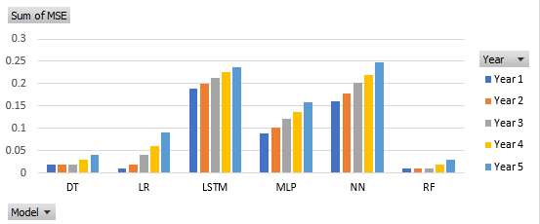
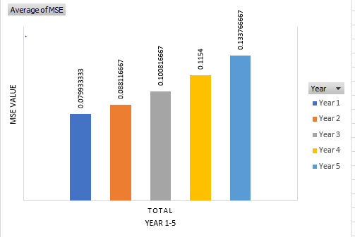
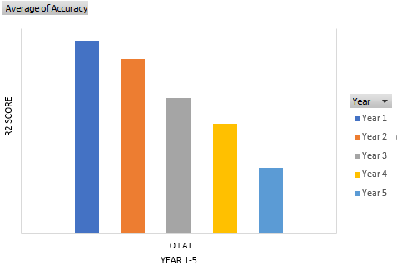
11
Conclusions

Slide 13
12
ANSWERING RESEARCH QUESTION
S/N | Research Question | Answer
1 | Can Random Forest (proposed model) be used to predict five years of carbon emission in Europe? | Yes
2 | Can the proposed model give better accuracy than the baseline machine learning models? | Yes
3 | Can the proposed model give better accuracy compared to cutting-edge deep learning models? | Yes

Slide 14
13
CONCLUSION
This study successfully met its aim of proposing a machine-learning model for predicting carbon emissions in Europe with high accuracy and a low error margin.
The proposed model outperformed the baseline machine learning methods and showed comparable accuracy with cutting-edge deep learning models in predicting carbon emissions in Europe for the upcoming five years.

Slide 15
14
FUTURE WORK
More variables that may impact carbon emissions, such as economic indicators, population growth, technological factors, and energy consumption, should be added to the dataset, run through the model, and compared to the accuracy of the present research result.
The study can be mirrored on a bigger scale into other continents and the world. The result of the research will propel the world in the right direction in terms of sustainable living

Slide 16
15
REFERENCES
Al-Haija, Q.A. and Smadi, M.A. (2020). Parametric prediction study of global energy-related carbon dioxide emissions. [online] IEEE Xplore Available from: https://doi.org/10.1109/ICECCE49384.2020.9179283 [Accessed 07 March 2023].
Hamrani, A., Akbarzadeh, A. and Madramootoo, C.A. (2020). Machine learning for predicting greenhouse gas emissions from agricultural soils. Science of The Total Environment, [online] 741, p.140338. Available from: https://doi.org/10.1016/j.scitotenv.2020.140338. [Accessed 24 Feb. 2023].
‌Hong, K., Jung, H. and Park, M. (2017). Predicting European carbon emission price movements. Carbon Management, [online] 8(1), pp.33–44. Available from: https://doi.org/10.1080/17583004.2016.1275813 [Accessed 24 Feb. 2023].
Lamb, W.F., Grubb, M., Diluiso, F. and Minx, J.C. (2021). Countries with sustained greenhouse gas emissions reductions: an analysis of trends and progress by sector. Climate Policy, [online] 22(1), pp.1–17. Available at: https://doi.org/10.1080/14693062.2021.1990831 [Accessed 10 Mach 2023].
Mardani, A., Liao, H., Nilashi, M., Alrasheedi, M. and Cavallaro, F. (2020). A multi-stage method to predict carbon dioxide emissions using dimensionality reduction, clustering, and machine learning techniques. Journal of Cleaner Production, [online] 275, p.122942. Available from: https://doi.org/10.1016/j.jclepro.2020.122942 [Accessed 24 Feb. 2023].

Slide 17
THANK YOU

